Slide 1
Team Work

Slide 2
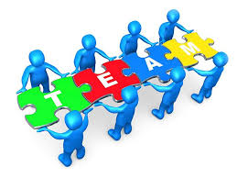
Team Work
It can be defined as a group of people who work together collaboratively to achieve a common goal.

Slide 3

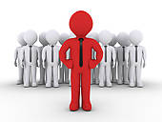


Features of a Good Team-
1.Clear Goals
2.Strong leadership
3.Defined roles
4.Communication

Slide 4
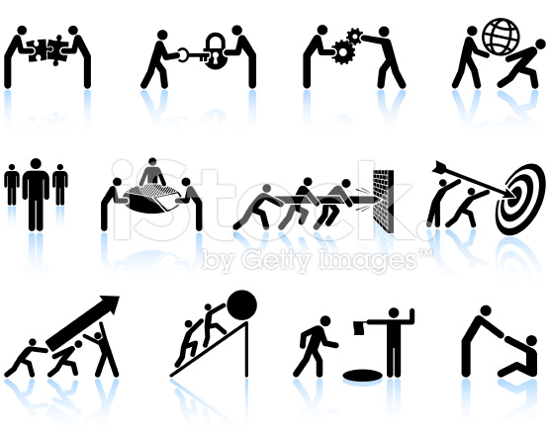
Do’S as a Team Member
know your team
Seek for Information
Clarify Doubts
Active Participation
Be Cooperative
Share Information
Practice active Listening
Support Others
Accept Feedback

Slide 5
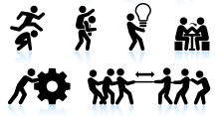
Do’S as a Team Member
Don’t work in isolation
Show attitude
Don't shy away from expressing
Don't complain
Don’t talk Negative
Don’t Argue
Don't interrupt

Slide 6

Summary
To progress in Career it is very important to a Good Team Member by active participants, Supporting the team and accepting the Feedback readily

Slide 7

What questions do you have?

